Slide 1
CASE PRESENTATION | WHO PLAYS VIDEO GAMES?
Anita Kishore | Satish Talluri | Tejaswi |Vinay Sekar

Slide 2
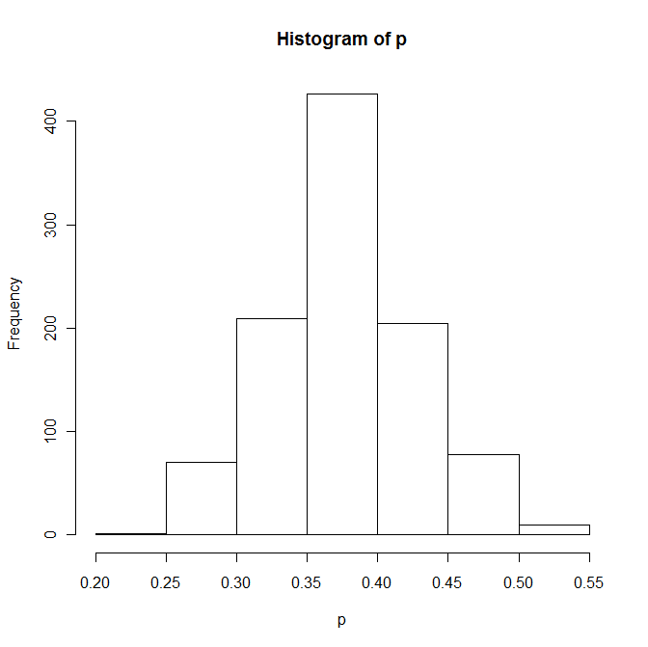
1. Fraction Estimation | Bootstrap
Estimation of fraction of students who played a video game in the week prior to the survey
Point Estimate: 0.3757
Standard Error: 0.0497
95% Confidence Interval
Percentile Interval: (0.2854, 0.4725)
Pivotal Interval: (0.2747, 0.4618)

Slide 3
2. Comparison of previous week and average reported times
Monotonic regression is used to estimate the average time a user spent given the frequency of his usage and the actual hrs
Overall average:
Average time spent(hrs) weekly 0.246689115
For the sample the average times for the people who have filled that they do not play when busy vs those who have filled that they will play when busy are given as:
  No-0.709311
  Yes-0.219993

Slide 4
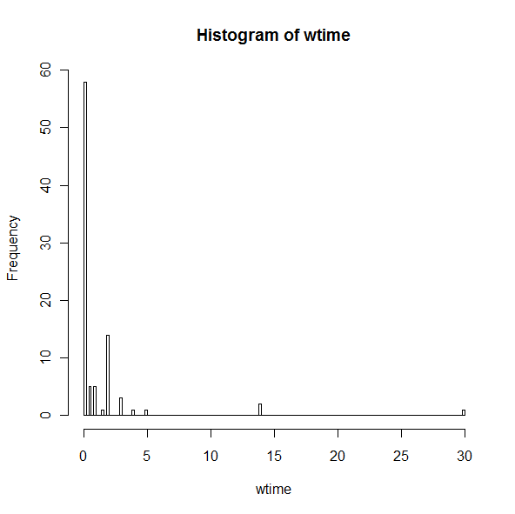
3. Average gaming time in the week prior to survey

Slide 5
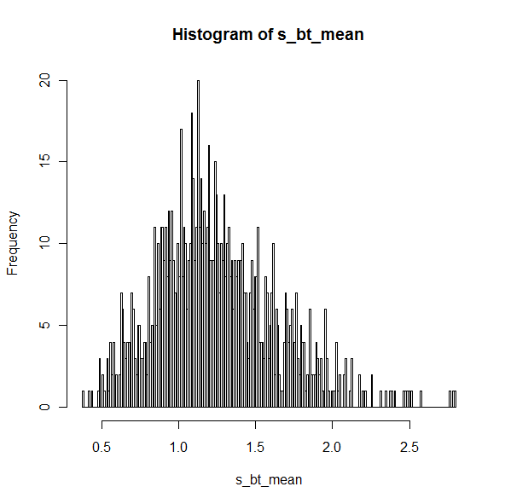
3. With out pruning of outlier data
Gaming time in prev week
Mean: 1.242857 hr/week
95% Confidence Interval 0.589011 < -- >2.089588

Slide 6
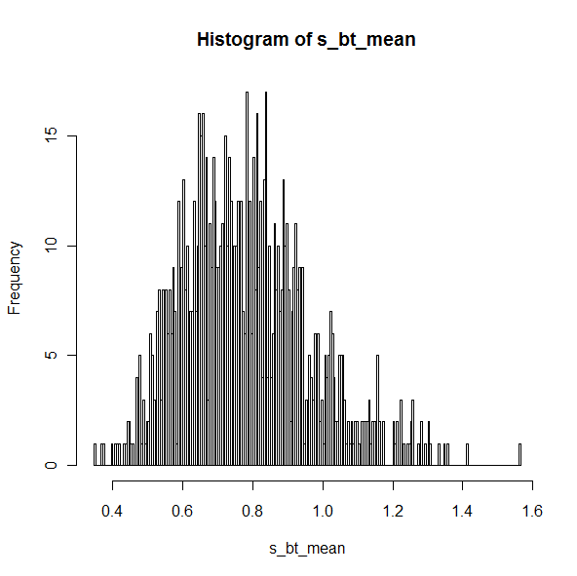
3. With pruning of data
Gaming time in prev week
Mean = 0.7764045 is:
Confidence Interval : 0.4628933 < --- >1.168596

Slide 7
4. “Attitude” Questions
Top 3 reasons for people to like video games
  Relaxation
  Feeling of mastery
  Bored
Top 3 reasons for people to dislike video games
  Too much time
  Costs too much
  It’s pointless

Slide 8
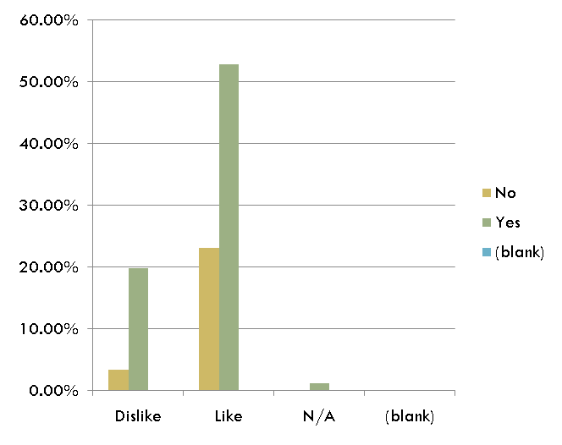
5. Demographic Comparisons
% of Total | sex
like/dislike | Female | Male | (blank) | Grand Total
Dislike | 12.09% | 10.99% | 0.00% | 23.08%
Like | 28.57% | 47.25% | 0.00% | 75.82%
N/A | 0.00% | 1.10% | 0.00% | 1.10%
(blank) | 0.00% | 0.00% | 0.00% | 0.00%
Grand Total | 40.66% | 59.34% | 0.00% | 100.00%
% of Total | own
like | No | Yes | (blank) | Grand Total
Dislike | 3.30% | 19.78% | 0.00% | 23.08%
Like | 23.08% | 52.75% | 0.00% | 75.82%
N/A | 0.00% | 1.10% | 0.00% | 1.10%
(blank) | 0.00% | 0.00% | 0.00% | 0.00%
Grand Total | 26.37% | 73.63% | 0.00% | 100.00%

Slide 9
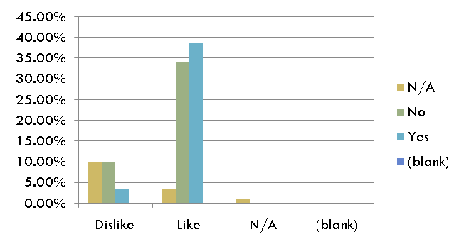
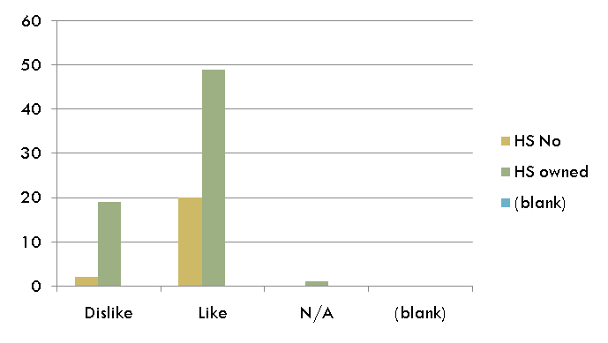
5. Demographic Comparisons
% of Total | educ
like | N/A | No | Yes | (blank) | Grand Total
Dislike | 9.89% | 9.89% | 3.30% | 0.00% | 23.08%
Like | 3.30% | 34.07% | 38.46% | 0.00% | 75.82%
N/A | 1.10% | 0.00% | 0.00% | 0.00% | 1.10%
(blank) | 0.00% | 0.00% | 0.00% | 0.00% | 0.00%
Grand Total | 14.29% | 43.96% | 41.76% | 0.00% | 100.00%
% of Total | home
like | HS No | HS owned | (blank) | Grand Total
Dislike | 2 | 19 |  | 21
Like | 20 | 49 |  | 69
N/A |  | 1 |  | 1
(blank)
Grand Total | 22 | 69 |  | 91

Slide 10
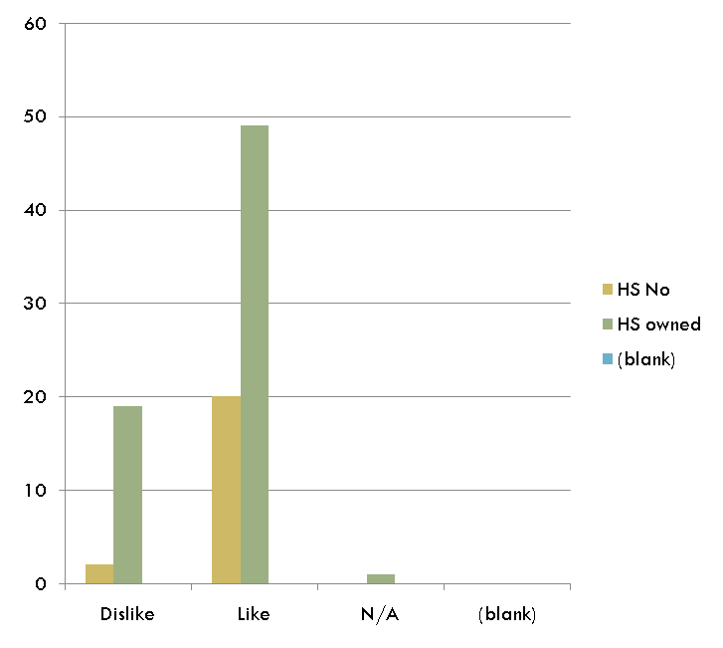
5. Demographic Comparison
% of Total | educ
like | N/A | No | Yes | (blank) | Grand Total
Dislike | 9.89% | 9.89% | 3.30% | 0.00% | 23.08%
Like | 3.30% | 34.07% | 38.46% | 0.00% | 75.82%
N/A | 1.10% | 0.00% | 0.00% | 0.00% | 1.10%
(blank) | 0.00% | 0.00% | 0.00% | 0.00% | 0.00%
Grand Total | 14.29% | 43.96% | 41.76% | 0.00% | 100.00%
% of Total | home
like | HS No | HS owned | (blank) | Grand Total
Dislike | 2 | 19 |  | 21
Like | 20 | 49 |  | 69
N/A |  | 1 |  | 1
(blank)
Grand Total | 22 | 69 |  | 91

Slide 11
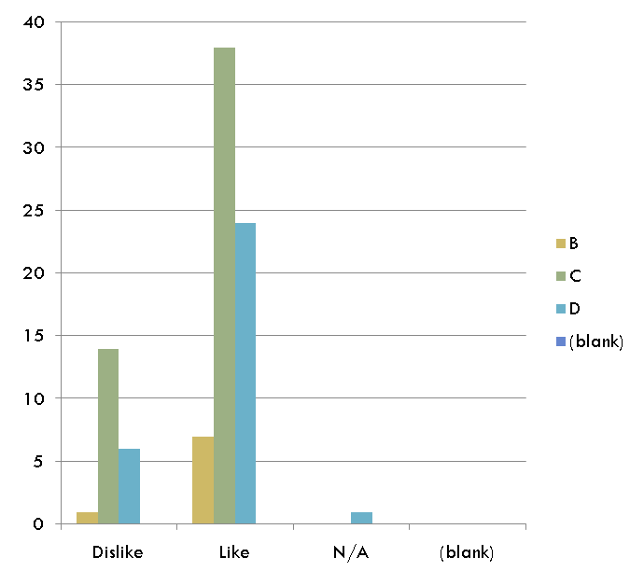
5. Demographic Comparisons
% of Total | math
like | Don't Hate | Hate It | N/A | (blank) | Grand Total
Dislike | 12.09% | 10.99% | 0.00% | 0.00% | 23.08%
Like | 54.95% | 19.78% | 1.10% | 0.00% | 75.82%
N/A | 0.00% | 1.10% | 0.00% | 0.00% | 1.10%
(blank) | 0.00% | 0.00% | 0.00% | 0.00% | 0.00%
Grand Total | 67.03% | 31.87% | 1.10% | 0.00% | 100.00%
Count | grade
like | B | C | D | (blank) | Grand Total
Dislike | 1 | 14 | 6 |  | 21
Like | 7 | 38 | 24 |  | 69
N/A |  |  | 1 |  | 1
(blank)
Grand Total | 8 | 52 | 31 |  | 91

Slide 12
6. Grade correlations
H0 : Actual grade distribution :
A : 0.2 ; B : 0.3 ; C: 0.4 ; D or lower : 0.1
H1 : Sample distribution
A : 0.34 ; B : 0.57 ; C: 0.087 ; D or lower : 0
Using chi-square test ::
P(X^2 > 62.06) = 2.12e-13,
Since p-value is very low, H0 is rejected , so correlation is pretty poor.
Even after adjusting for non-respondents,
P is 4e-12, So Ho is again rejected.
Expectations from students are higher !!!

